Slide 1
Adult Outplant Site Improvement Update
Jeremy Appt Technical Lead CENWP EC-DG
David Leonhardt CENWP PM-E
July 23, 2013

Slide 2
Sites Above Detroit Dam
Collection Facility: Minto
Gordon Road Site – located in North Santiam sub-basin at relatively lower position, commissioning complete, evaluation of release pipe ongoing
USGS Site – located in Breitenbush sub-basin at lower position, commissioning complete, evaluation of release pipe ongoing
Villa Maria Site - located in Breitenbush sub-basin at upper position, commissioning not complete, dynamic channel morphology has eliminated plunge pool, no consensus on release into riffle, evaluation of upper basin strategy ongoing, search for another upper basin site also ongoing

Slide 3
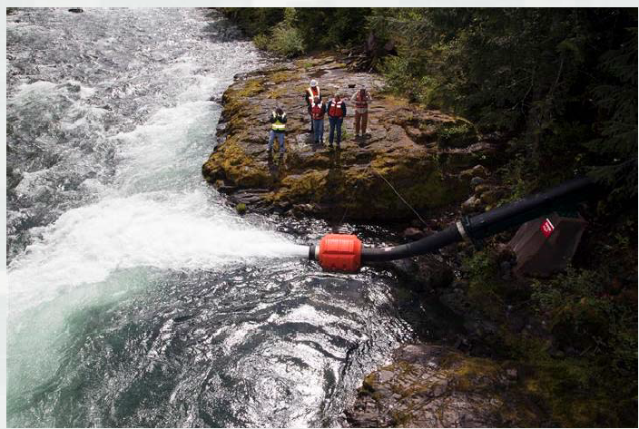
Coopers Ridge

Slide 4
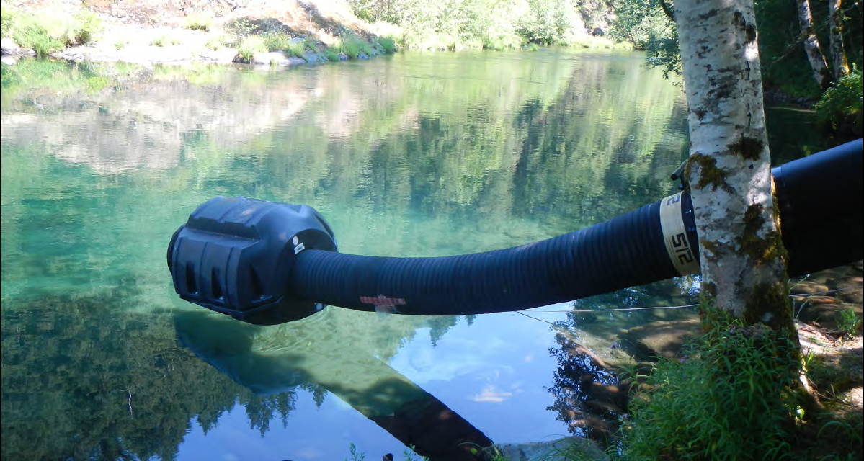
USGS Site

Slide 5
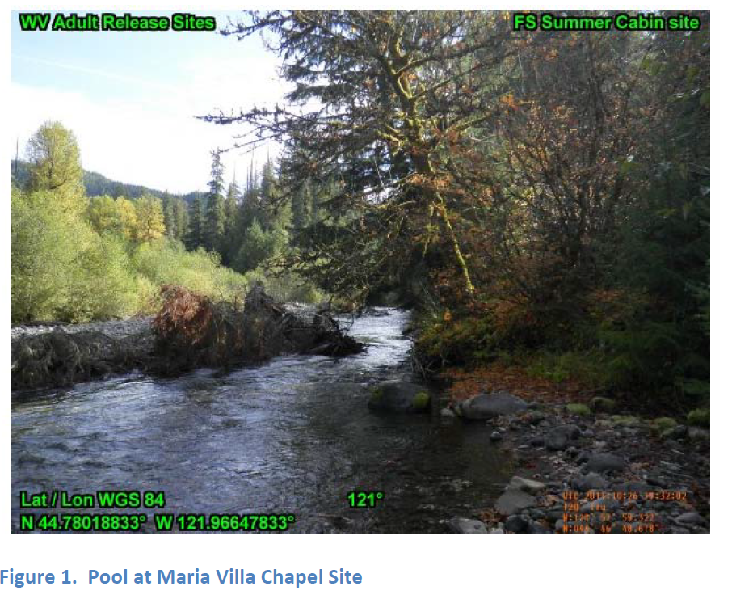
Villa Maria
Oct 2011
Pool no longer exists, release point upstream of leaning tree

Slide 6
Sites Above Foster Dam
Collection Facility: Foster
Riverbend County Campground – located in South Santiam sub-basin at relatively lower position, currently run as primary use site by ODFW, no improvements made by USACE
Gordon Road– located in South Santiam sub-basin at upper position, commissioning complete, evaluation of release pipe ongoing

Slide 7
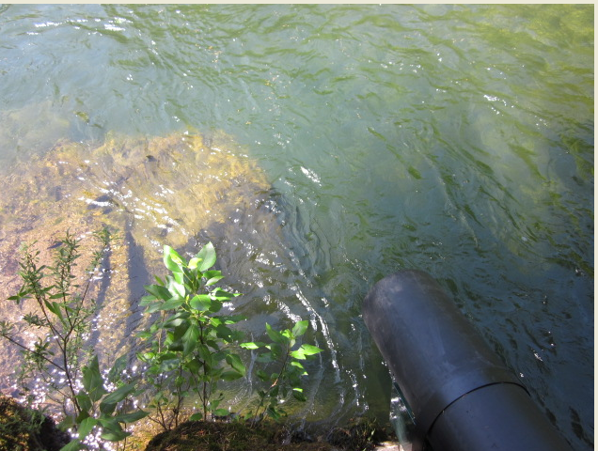
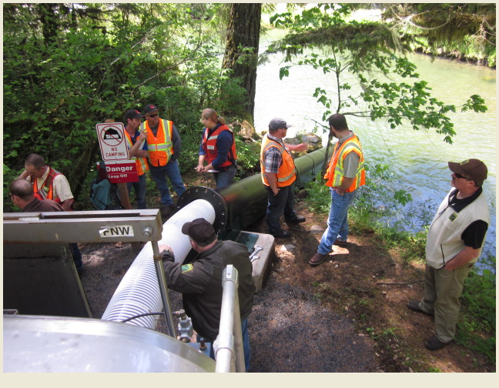
Gordon Road

Slide 8
Sites Above Cougar Dam
Collection Facility: Cougar Creek
Slide Creek Campground – Existing use, no improvements, access agreements acquired.
Hard Rock – Existing use, no improvements, access agreements acquired.
Homestead– located in McKenzie sub-basin in upper position, commissioning complete, however release pipe needs improvement

Slide 9
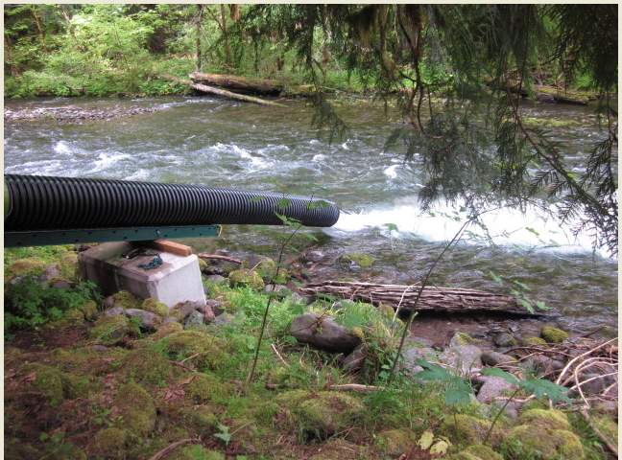
Homestead

Slide 10
Sites Above Dexter/Fall Creek Dams
Facilities: Fall Creek collection and Willamette Hatchery
Gold Creek– located in Middle Fork Willamette sub-basin in upper position, truck ramp only, commissioning pending
Alt Site #1 – Located in the North Fork Willamette sub-basin in upper position, truck chute release, commissioning complete

Slide 11
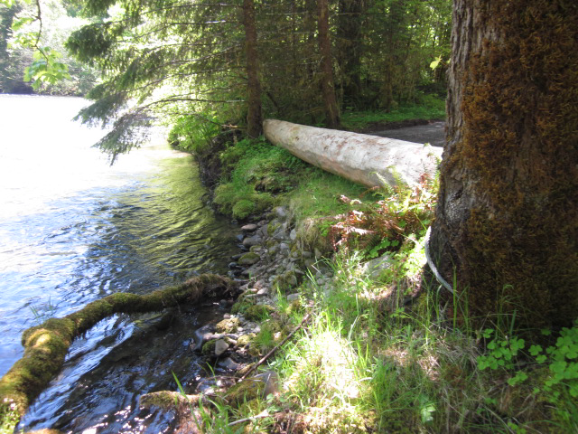
Alt Site #1

Slide 12
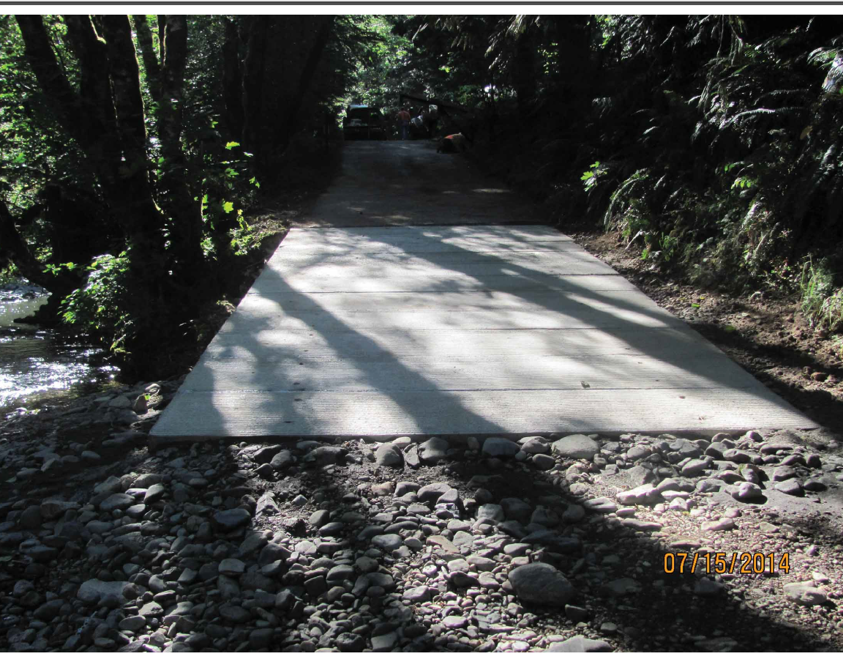
Gold Creek Truck Ramp

